Slide 1

Submitted to:
Ms Rubaldeep Gill
Submitted by:
Soni kumari
7th sem IT
Department Of CS/IT

Slide 2
GAME
JACK THE GIANT
With the help of
The best development platform for creating games
The Unity Editor

Slide 3
Purpose of the project
Introduction
Unity is a flexible and powerful development platform for creating
multiplatform 3D and 2D games and interactive experiences.
It's a complete ecosystem for anyone who aims to build a business on
creating high-end content and connecting to their most loyal and
enthusiastic players and customers.
As Unity Editor is one of the important platform for development of games,
Jack the giant is a unity based game designed by the purpose of
learning working of unity editor,from basic to advance technique.

Slide 4
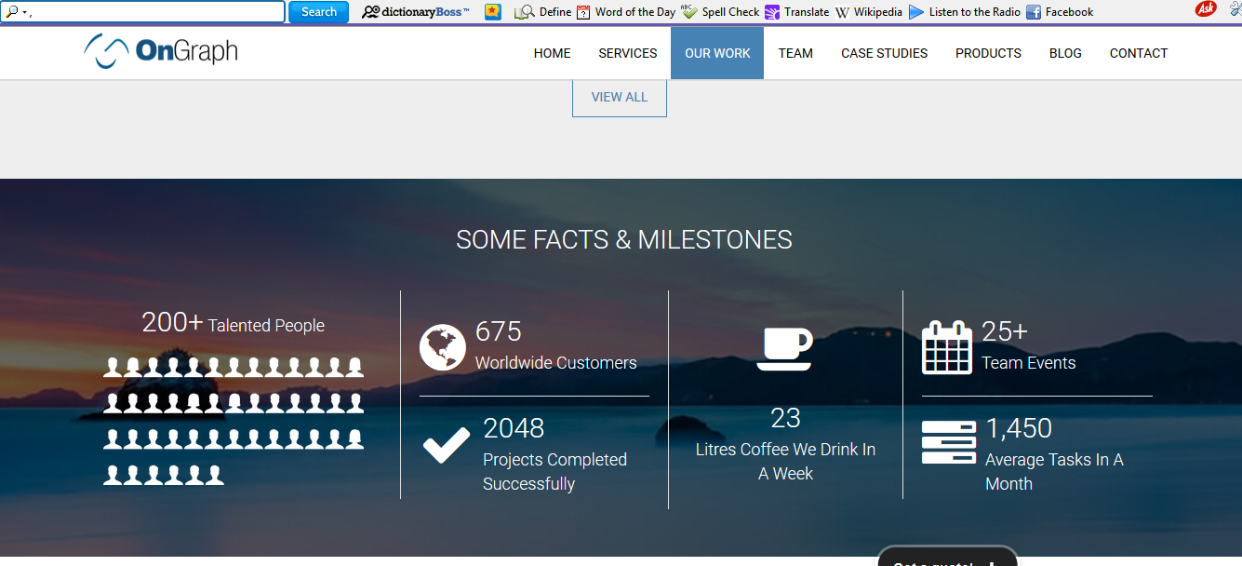
About the company

Slide 5

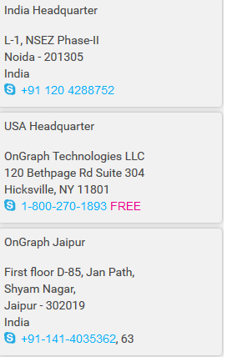


Contact details:

Slide 6

Recent Products

Slide 7

Case Studies :-
Present Case Studies

Slide 8


About Editor
Reference:
http://docs.unity3d.com
Contents:
Introduction
Installing
Unity Basics
Scripting
Assets
Scenes
Game Objects
Prefabs
Build
ibjects.com

Slide 9
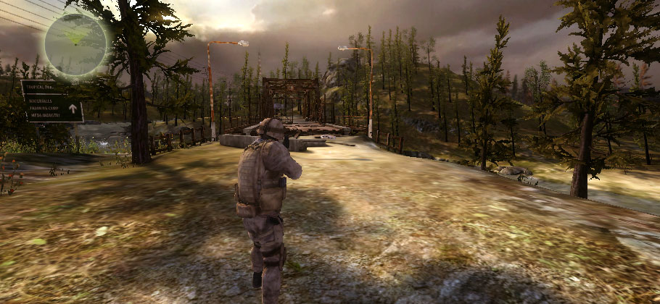
Graphics of Unity:
A screen shot of the game created using Unity 3D Engine for PC.
As you can see in the screen shot that the graphics are realistic. See how the shadow of tree is accordingly to the sun light and the rest of graphics are also giving it a realistic view. You also play these type of games now a days in your PC’s. Ever wonder how they are created? Well now you can do it using Unity Engine.
Introduction
ibjects.com

Slide 10
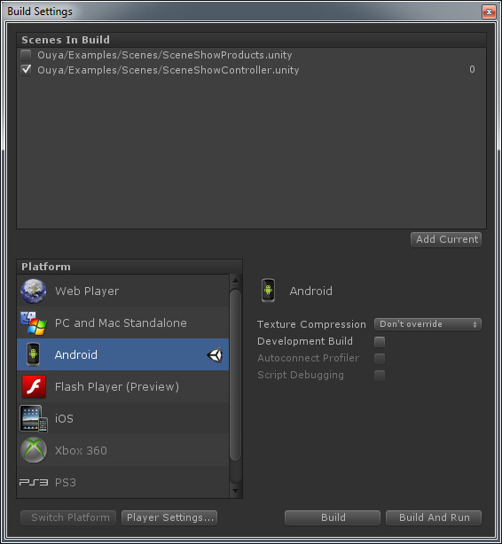
Platform:
The extension of a unity file is .unity. You can make games on unity for different platforms that include Android and iOS.
This screen shot is showing the platforms on which you can export your .unity file.
So now you see the unity is a huge tool if you are interested in game development.
However, in these slides we will only cover Unity for PC games.
Unity is a freeware software. Bur it is now freeware if you want to use it for commercial purpose. (Selling your games in market)
Introduction
ibjects.com

Slide 11

What is Unity?
Unity is a multi-platform, integrated IDE for scripting games, and working with 3D virtual worlds Including:
Game engine
3D objects / lighting / physics / animation / scripting
Accompanying script editor
MonoDevelop (win/mac) << RECOMMENDED TO USE
Can also use Visual Studio (Windows)
3D terrain editor
3D object animation manager
GUI system
Executable exporter many platforms: Native application / web player / iPhone / Android / Wii
Introduction
ibjects.com

Slide 12
Installing Unity 3D
System Requirements
Windows: XP SP2 or later; Mac OS X: Intel CPU & "Snow Leopard" 10.6 or later.
Note that Unity was not tested on server versions of Windows and OS X.
Graphics card with DirectX 9 level (shader model 2.0) capabilities. Any card made since 2004 should work.
Using Occlusion Culling requires GPU (Graphics Processing Unit) with Occlusion Query support (some Intel GPUs do not support that).
Installation
Installing Unity 3D is simple.
Download the latest Unity distribution from http://unity3d.com/unity/download/
Run the installer with default settings.
Run Unity for the first time. It may open the demo project, or it will ask you to create a project. Open the demo or create a new project without changing any settings.
Follow the instructions to register online, fill out your email address and just use the free/indie license.
Installing
ibjects.com

Slide 13
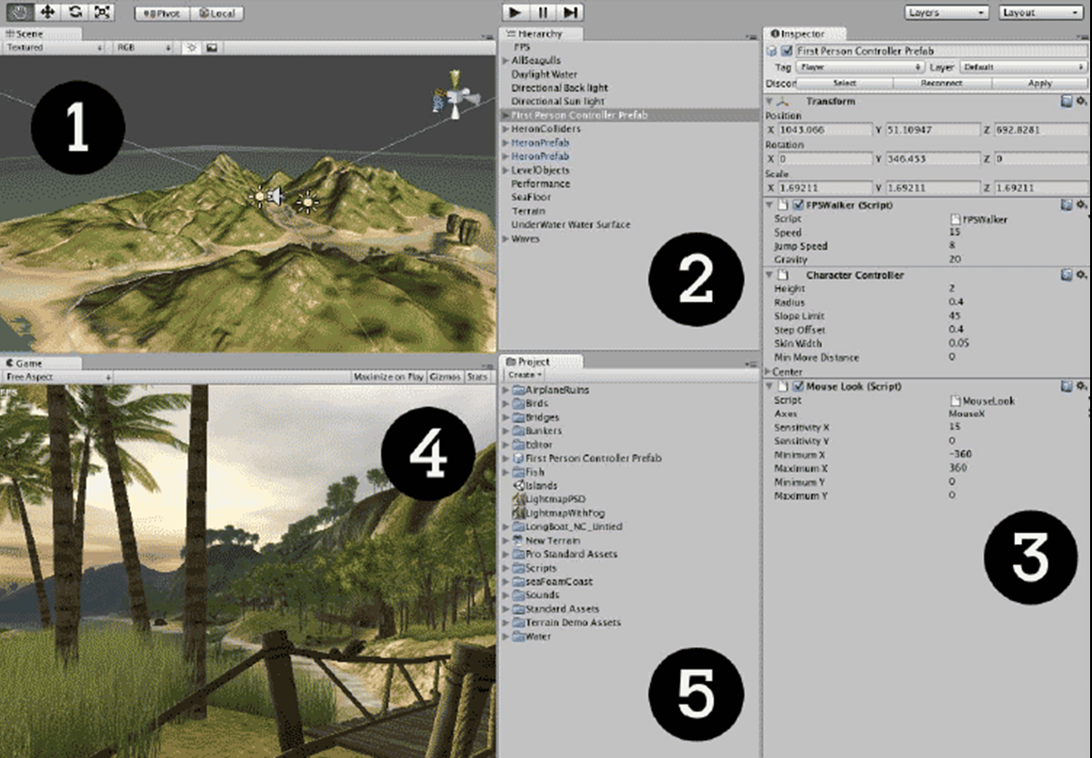
Unity Basics
Screen Shot of Unity Main Interface with a Project Opened
Unity Basics
ibjects.com

Slide 14

Unity Basics
1 – Scene
Scene is same as Hierarchy(2) = same, just diff. views
Editable (design-time) 3D game objects in the current scene
2 – Hierarchy
Text list of game objects and sub-objects in the current scene
3 – Inspector
Properties for currently selected
4 – Game
Preview how game will look when executing
5 – Project
Contents of Project ‘assets’ folder (i.e. files in that folder) – library of scripts, digital media files, and scenes
Unity Basics
ibjects.com

Slide 15
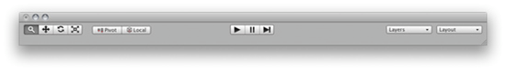
Unity Basics
This is the top most bar below Menu Bar in Unity Main Interface Window.
Click-drag to drag the camera around
Hold Alt and click-drag to orbit the camera around the current pivot point.
Hold Control and click-drag to zoom the camera.
These three buttons help you test your game and control playback. As you've seen, the Play button starts and stops your game. The Pause button works as expected—it pauses your game so that you can make changes to it on the fly. The third button is a Step-Through control; use it to advance frame-by-frame through your game so that you can more tightly control what's going on.
Above the Inspector panel, you'll see the Layers and Layout dropdowns. Game Objects can be grouped into layers, much like in Photoshop or Flash. Unity stores a few commonly used layouts in the Layout dropdown. You can also save and load your own custom layouts.
Unity Basics
ibjects.com

Slide 16
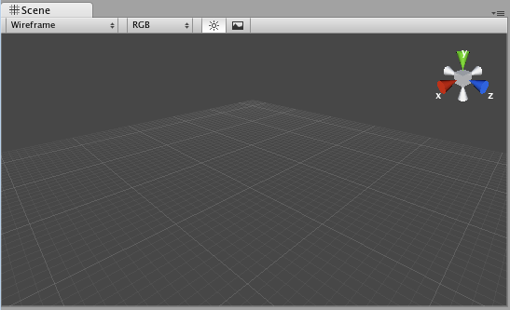
The Scene window
The Scene window is where you can position your Game Objects and move things around. This window has various controls to change its level of detail. Use these controls to toggle lighing on and off, and to display the window contents with textures, wireframes, or a combination of both. You can use the colorful gizmo in the top-right corner to constrain the window to the X, Y, and Z axes to view the top and sides of your scene. Click on the white box in the middle to return to perspective view. This is what the Scene window looks like when you start a new project or create a new Scene.
Typical game
Welcome / main menu screen
Buttons: play game / see high scores / read instructions / change input settings
Level 1 / Level complete / Level 2 etc
Game Over / Enter details for new High Score …
All the above would be separate “scenes” in unity
Some scenes may be entirely based around the Unity GUI scripts / components – i.e. be text / buttons on screen
Unity Basics
ibjects.com

Slide 17
Adding a Plain to Scene

Slide 18
Modifying the Plain
Change X and
Z to 20
Experiment to find suitable scale
Y should be 1
These should be
0
Drag-and-drop
ground to plain

Slide 19
Navigating in Unity
Move tool (shortcut: W)
Play Mode
Rotate tool (shortcut: E)
Scale tool (shortcut: R)
Hand tool (shortcut: Q)
click-drag to move camera
ALT click-drag to orbit camera around
CTR click-drag to zoom
On scene view:
F to zoom to selected object
Hold right mouse to enable
ASWD movement
Q up, E down

Slide 20
Save a Scene
File -> Save Scene
Name it “First”
Or something else

Slide 21
Time to Test
Hit Play

Slide 22
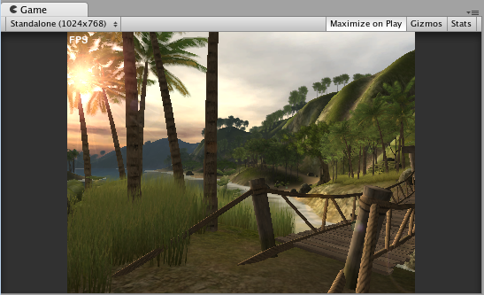
The Game Window
The Game window shows you what your players will see. When you click on the Play button to test your game (as you just did with the Island Demo), the results of your efforts play out in this window. Toggle the Maximize on Play button to test your game in full-screen mode.
Unity Basics
ibjects.com

Slide 23
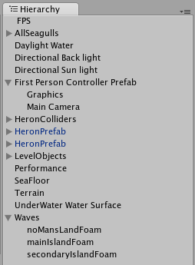
Hierarchy Panel
The Hierarchy panel lists all of the Game Objects in your Scene. Game Objects - cameras, lights, models, and prefabs—are the things that make up your game.
They can be "tangible" things like the birds and the bridge in the Island Demo. They can also include intangible things, which only you as the game developer get to see and play with, such as the cameras, the lights, and colliders, which are special invisible shapes that tell the game engine when two Game Objects are touching.
So, Game Objects can include touchy-feely "physical" objects like birds and bridges, as well as behind-the-scenes intangible things like lights, cameras, and actions (scripts).
Click on a Game Object in the Hierarchy panel, and then hover your mouse over the Scene window. Press the F key on your keyboard, and the Scene window will automatically pan and zoom directly to that object. Alternatively, you can go to Edit | Frame Selected, which can be more reliable than using the keyboard shortcut. (I like to think of the F as standing for Focus to help me remember what this shortcut does).
Unity Basics
ibjects.com

Slide 24
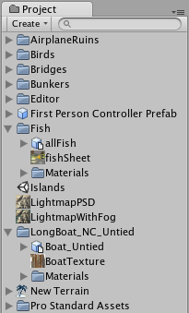
Project Panel
It lists all of the elements that you'll use to create Game Objects in your project.
The Project panel contains many of the elements, or ingredients, that go into making our Game Objects.
The Project panel displays the contents of a special folder called Assets. Unity automatically creates the Assets folder for you when you create a new project. If you drag a compatible file, like a 3D model, a sound effect, or an image into the Project panel, Unity copies it to the Assets folder behind the scenes, and displays it in the Project panel.
Don't mess with the Assets folder! Unity stores metadata about the folder, and by moving stuff around or deleting things through your operating system, you may break your project. If you need to make changes, make them right inside Unity in the Project panel.
Unity Basics
ibjects.com

Slide 25
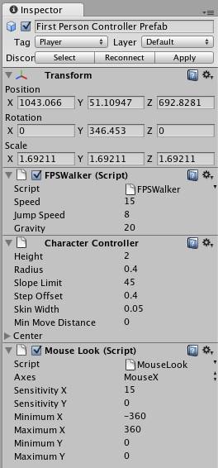
The Inspector
The Inspector is a context-sensitive panel, which means that it changes depending on what you select elsewhere in Unity. This is where you can adjust the position, rotation, and scale of Game Objects listed in the Hierarchy panel.
The Inspector can also display controls to configure components that add functionality to Game Objects.
Between the three main panels in Unity (Hierarchy, Project, and Inspector), the Inspector is where you'll likely spend most of your time because that's where you'll be tweaking and fiddling with every aspect of the elements that comprise your game projects.
Unity Basics
ibjects.com

Slide 26
Scripting
Unity implements a MONO compiler
Scripts can be written in
JavaScript
Note – most introductory tutorials are written in Javascript – for those learning programming its fine
C#
Very similar to Java, Unity can be integrated with the Microsoft Visual Studio editor, to get full benefits of code completion, source version control etc.
Serious developers work in C#
In Unity, select from the menu Assets->Sync VisualStudio Project
Find the newly created .sln file in your Unity project (one folder up from your Assets folder)
Open that file with Visual Studio Express.
In Unity, go to Edit->Preferences, and make sure that Visual Studio is selected as your preferred external editor.
Doubleclick a C# file in your project. Visual Studio should automatically open that file for you.
You can edit the file, save, and switch back to Unity.
You can now edit all your script files, and switch back to Unity to use them.
Scripting
ibjects.com

Slide 27
Game Objects
Everything in a scene is either a Game Object or a component inside a Game Object
Every Game Object has at least 1 COMPONENT
Its TRANSFORM – an object’s position, scale, rotation
Other components depend on object type (audio, mesh, material, script etc.)
Game objects can be in a HIERARHCY – so an object can be a sub-object of another object
E.g. an “arm” object can be a sub-object of a “body” object etc.
Prefabs
Since object-oriented (although this is partially hidden when scripting in JavaScript) instances can be INSTANTIATED at run time.
Unity uses the term PREFAB for a pre-fabricated object template (i.e. a class combining 3D objects and scripts)
At DESIGN TIME (in editor) a prefab can be dragged from Project window into the Scene window and added the scene’s hierarchy of game objects. The object can then be edited (i.e. customised from the prefab default settings) if desired
At RUN TIME a script can cause a new object instance to be created (instantiated) at a given location / with a given transform set of properties
Game Objects & Prefabs
ibjects.com

Slide 28
Asset
Unity will automatically detect files as they are added to your Project folder's Assets folder. When you put any asset into your Assets folder, you will see the asset appear in your Project View.
Asset Store
Unity's Asset Store is home to a growing library of free and commercial assets created both by Unity Technologies and also members of the community.
A wide variety of assets is available, covering everything from textures, models and animations to whole project examples, tutorials and Editor extensions. The assets are accessed from a simple interface built into the Unity Editor and are downloaded and imported directly into your project.
You can open the Asset Store window by selecting Window->AssetStore from the main menu. On your first visit, you will be prompted to create a free user account which you will use to access the Store subsequently.
Location of Downloaded Asset Files
You will rarely, if ever, need to access the files downloaded from the Asset Store directly. However, if you do need to, you can find them in
~/Library/Unity/Asset Store ...on the Mac and in
C:\Users\accountName\AppData\Roaming\Unity\Asset Store ...on Windows. These folders contain subfolders that correspond to particular Asset Store vendors - the actual asset files are contained in the appropriate subfolder
Asset
ibjects.com

Slide 29
Build
From the menu bar select File -> Build Settings
Select Scenes to Build Select Platform
Click Build And Run
Build
ibjects.com

Slide 30
About Project: Jack The Giant
It is Unity Editor based project made by the purpose of learning
working of Unity Editor.
Here in my project it is consist of different scenes:-
Main Menu Scene
High Score Scene
Game Scene
Option Scene
We can directly open different different Scenes and do editing.
We can also convert this into its apx file and can run on any type
Of android phone.
Unity Editor provides with the facility to run project on those pc also
Which do not have unity editor installed.

Slide 31
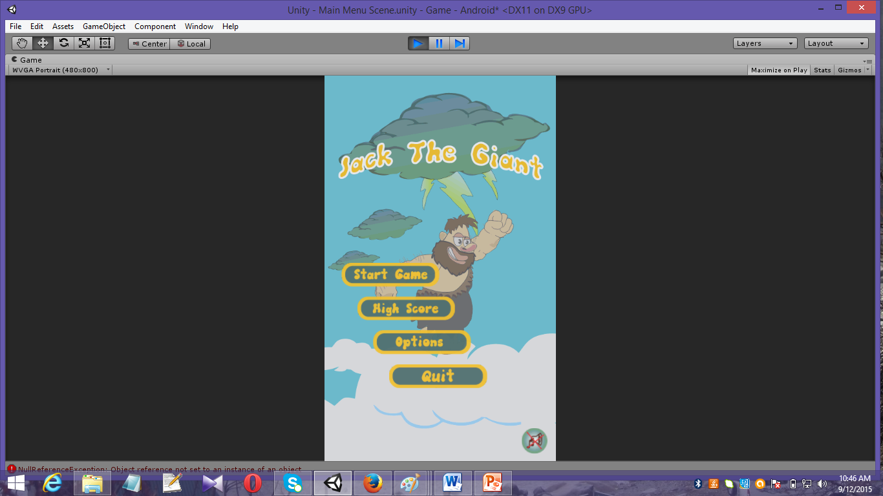
Different Scenes of the game
Main Menu Scene

Slide 32
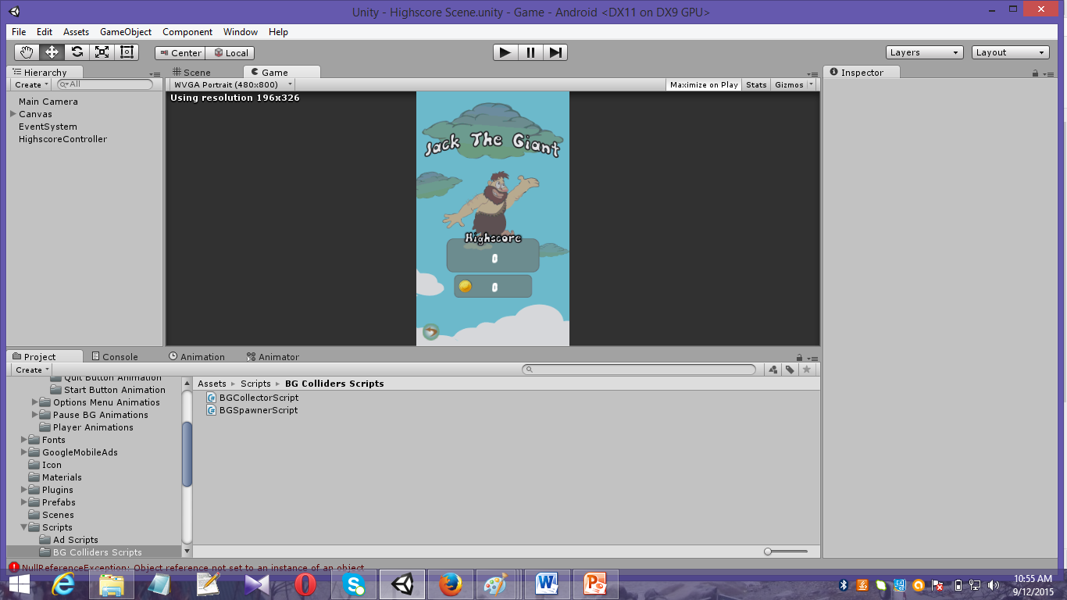
High Score Scene

Slide 33
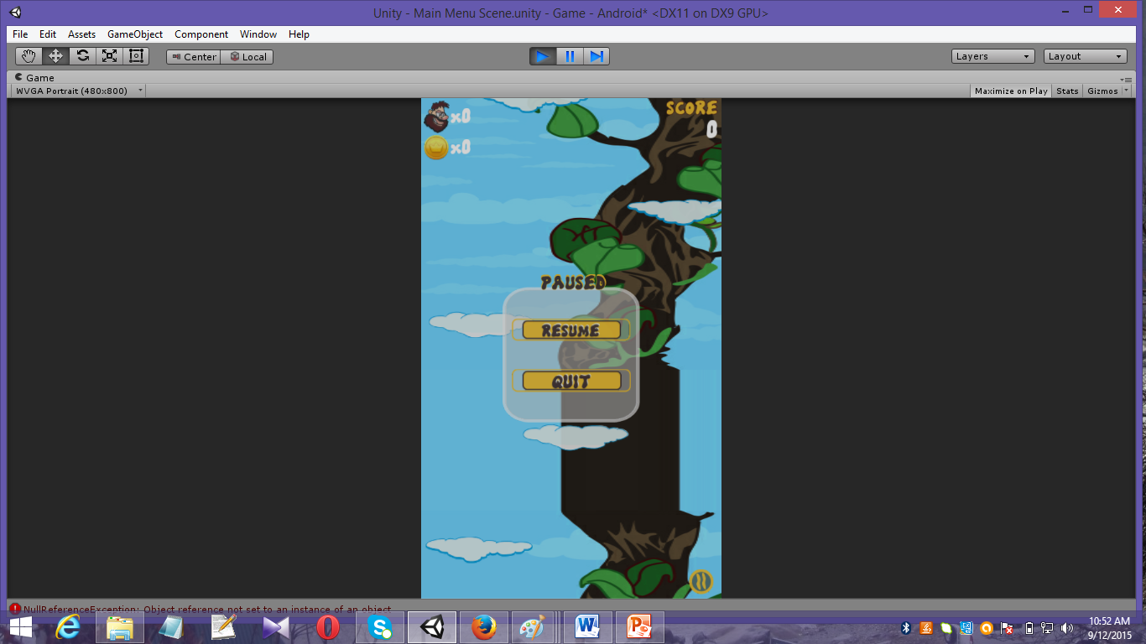
Different options in scene

Slide 34

Thank You

